Slide 1

GUVI CAPSTONE PROJECT
Crafting Compelling Web Presences MBM6
Presented By:
Laksmi Priya m

Slide 2

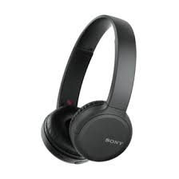
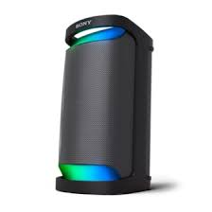
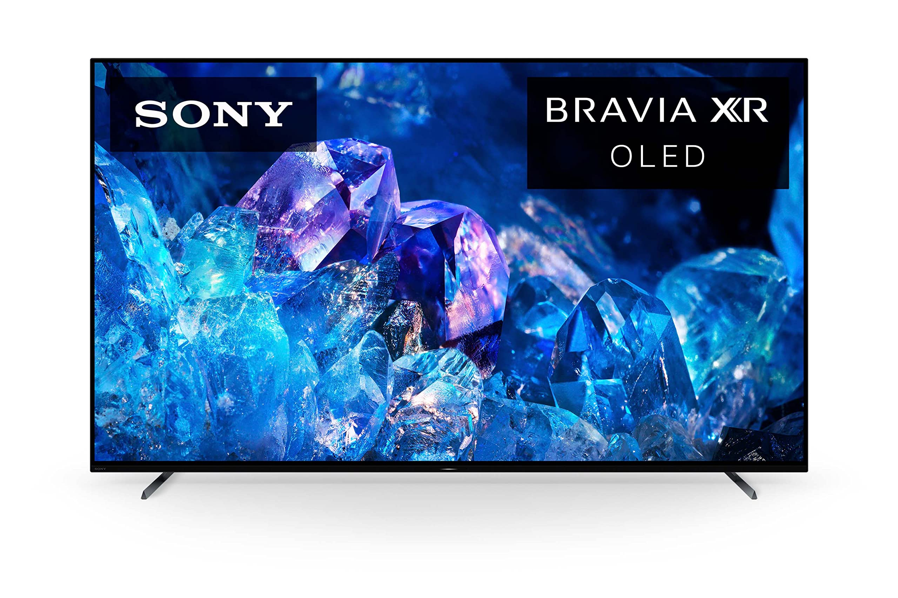
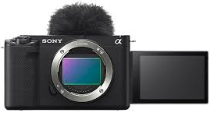
PRODUCTS TO BE COVERED
Sony TV
Headphones
Interchangeable lens Camera
Wireless Speaker

Slide 3
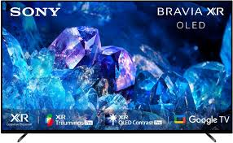
SONY TV
Description:
The Television is powered by XR processor to make it as real visual for the Audience.
XR OLED Intelligent motion processing for smooth, fast-moving action and picture quality is upscaled to 4K.
XR OLED is adaptive calibrated mode, works based on the show to room lighting conditions.
Bravia Core calibrated mode including iMAX enchanced and adjustments of title to the picture to experience movie from home.
Game Features: Screen image simulated, atmospheric sound, Auto HDR tone Mapping, Genre Picture Mode.
Eco: Optimising brightness and power consumption, eco settings in one place.
The design is beautiful made durable with less virgin plastic.
Sound: The sound is from center of the screen perfectly matching the scene rather than beneath the screen like conventional TV.
Voice Zoom2 detects voice, analyses them and improves the clarity.

Slide 4
SONY TV
Smart features: Connect to different apps, control the Tv with voice assistant , Cast image , video from phone to Tv easily.
Added advantage Compatible with Apple AirPlay and Siri to control your TV with the voice assistant.
Add-ons: Kids profile helps to guide the kids with age appropriate shows , game and other contents.
BRAVIA CAM
Proximity alert when kids or adults gets closer to the TV, Video call with family and friends when we pair with camera. Attaching and detaching BRAVIA CAM is so easy just with one swipe.
DESIGN
The stand is stylish , aluminium slim wedged stand with a diamond shaped cross section makes it even thinner.
The one slate design minimises noise and maximises the experiences
The metal flush surface makes our eyes to focus on the screen rather than the outer surface.

Slide 5
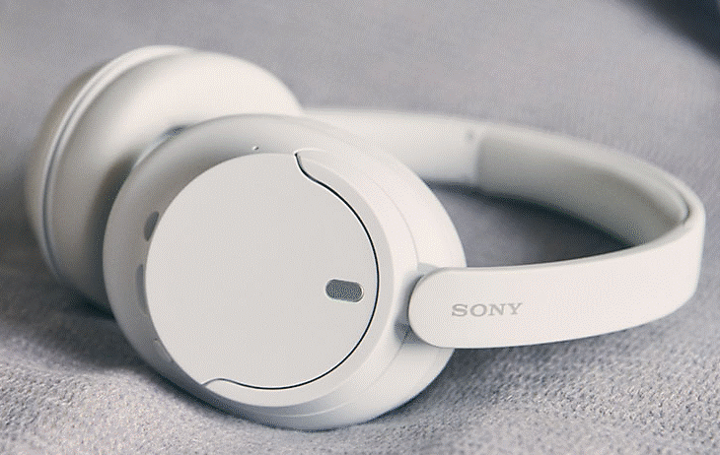
HEADPHONES
DESCRIPTION:
Battery life is up to 35 hours. Quick charge for 3 minutes will give extra 60 minutes of charge.
The integrated Processor V1 provides authentic experience with minimal distortion.
The Digital Sound Enhancement Engine (DSEE)restores to produce high-quality sound that’s closer to original recording.
Multipoint connection.
Buttons located help to play, stop and adjust the volume.
Hands-free help through voice assistant.
Effortless Bluetooth pairing.
Beamforming microphones with precise voice pickup
Technology.
Noise cancelling headphones with newly noise reduction
structure.

